Slide 1



Home
Service
About Us
Contact
CUSTOMER DATA
MANAGEMENT AND ANALYSIS

Slide 2



Studio Shodwe
OUR TEAM
Home
Service
About Us
Contact
Ziad Afify
Sama Mossad
Senior Accountant
AI Student
Samar Fawzy
CS Student
Hasnaa ElBosaty
Mohamed Badr
Engineering student
AI Student

Slide 3
Introduction
Enhancing Customer Experience through Data-Driven Insights
This project aims to leverage the power of data science and cloud technologies to gain a deeper understanding of customer behaviour, preferences, and needs. By establishing a robust data infrastructure and employing advanced analytical techniques, we will develop predictive models to anticipate customer churn, optimise marketing campaigns, and personalise customer experiences.

Slide 4
Problem we seek to solve:
Many companies struggle to retain customers and drive repeat purchases. Traditional customer relationship management (CRM) systems often fall short in providing actionable insights and predictive capabilities
The Soultion we offer:
This project addresses the critical challenge of predicting customer behaviour, specifically whether a customer will remain loyal or churn. By analysing historical purchase data and leveraging machine learning techniques, we aim to develop a predictive model that can accurately identify customers at risk of attrition

Slide 5
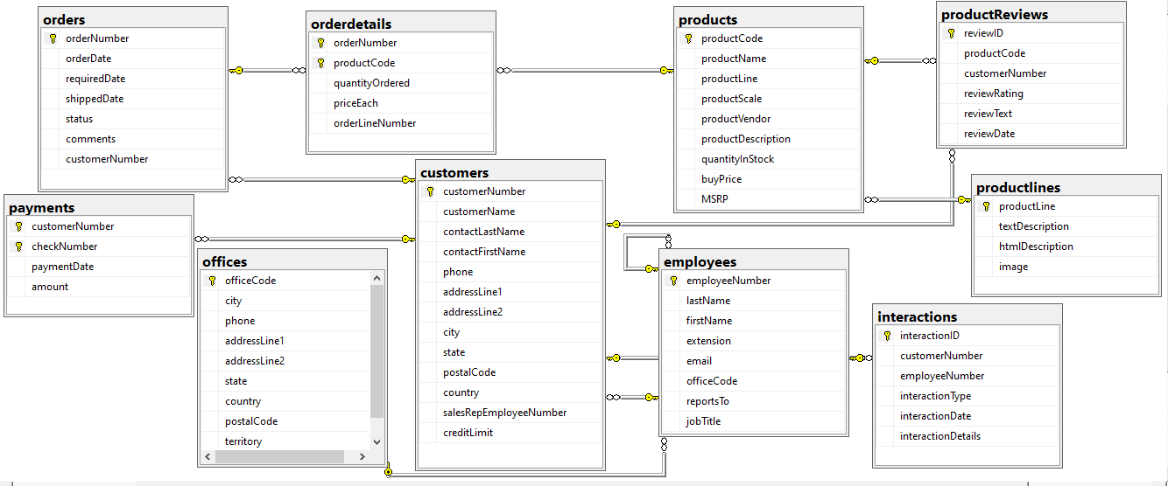
Design and implement the Database
Objective:
To build a robust customer data management system, capable of handling customer information, transactions, and interactions.
Database Structure:
The database is designed using Microsoft SQL Server.
It follows a relational schema,
where key entities (customers, employees, products, transactions, and interactions)
are interconnected to maintain
data integrity and support
complex queries.
Core Features:
Customer and Transaction
Management: Track customer
details, their orders, payments,
interactions with company employees .

Slide 6
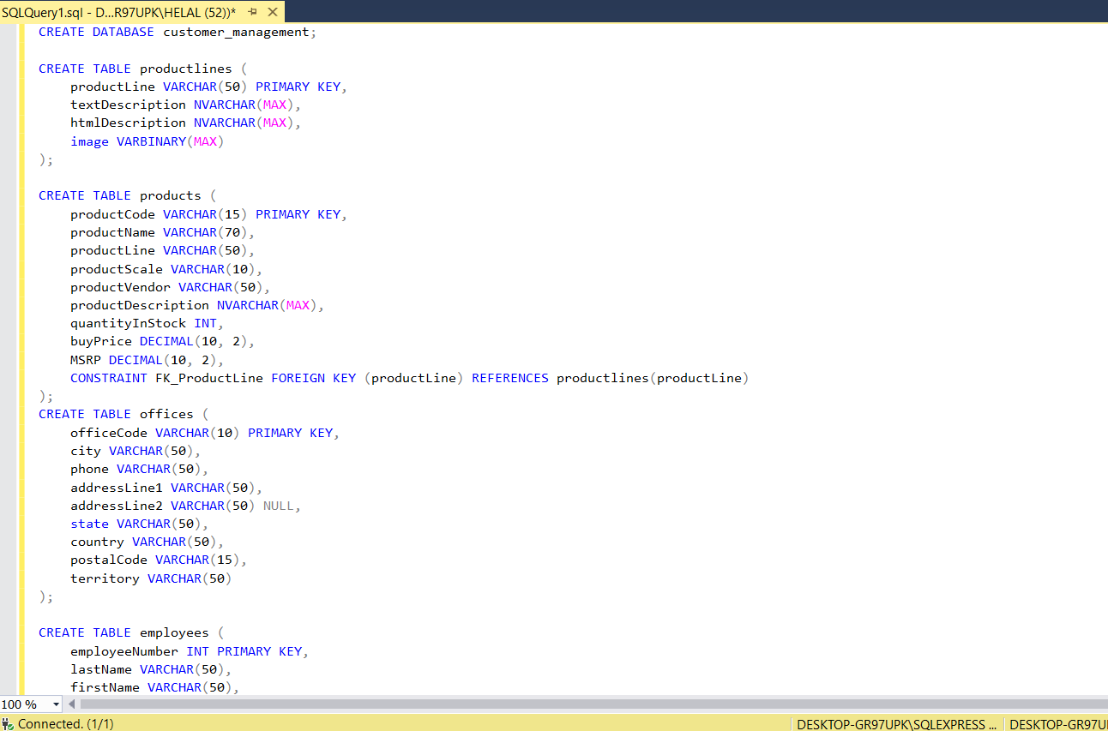
Implementation Process and Data Population
Implementation Steps:
Database Schema Design:
Carefully planned the structure
using
relational tables for key data
entities, ensuring that foreign keys
maintain data consistency.
SQL Queries:
Created SQL scripts for table
creation, ensuring each table and
its relationships were clearly defined.

Slide 7
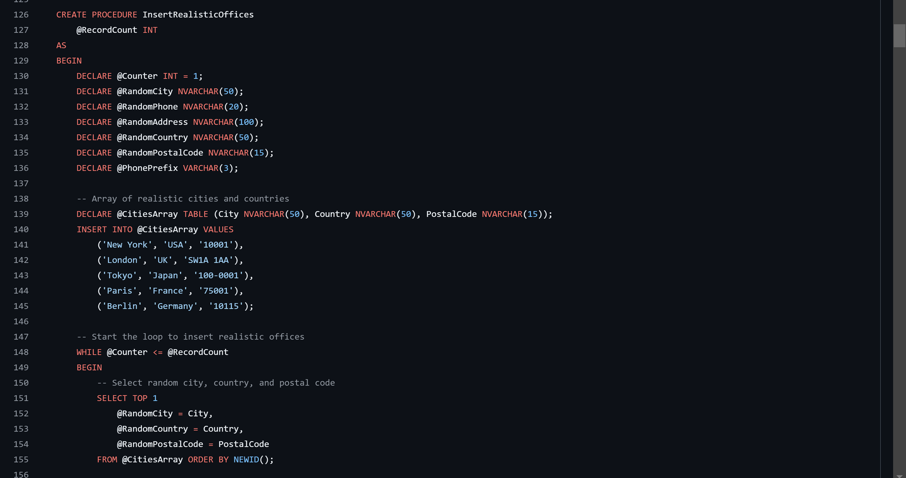
After creating the database and its structure, the next step was to download the data.
After creating the database and its structure, the next step was to load the data.
We loaded the data into the different tables in the database using an organized and efficient process
In the data entry process, we created a generating function for our data. This function enables us to generate large amounts of data automatically.

Slide 8
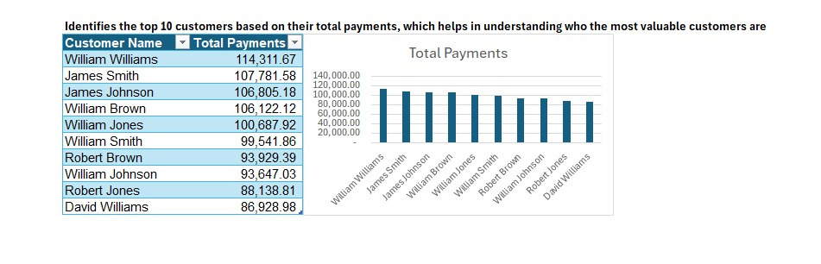
Business Analysis
These analyses will explore some key insights derived from our data. By examining customer behaviour analytics, sales trends, and inventory levels, we aim to provide actionable recommendations to enhance operational efficiency and drive business growth.
Based on these observations, the following recommendations can be made:
Prioritise high-value customers:
Focus on retaining and nurturing the top 10 customers through personalised marketing campaigns, exclusive offers, and exceptional customer service.
Implement loyalty programs to reward repeat business and encourage further spending.

Slide 9
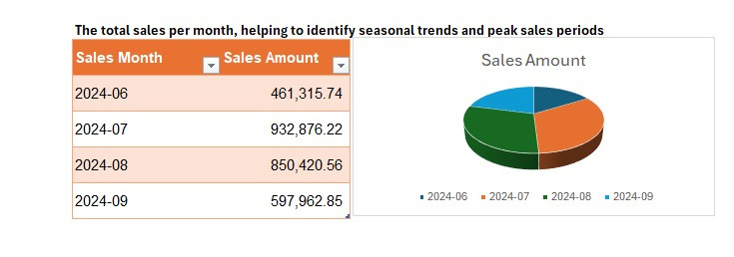
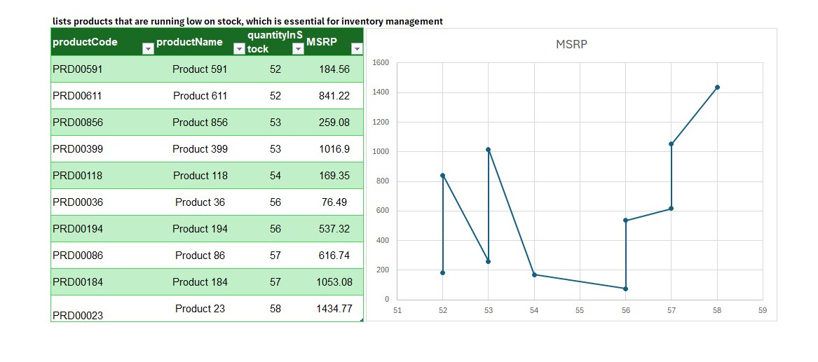
Based on these observations, the following recommendations can be made:
Investigate Sales Decline:
Conduct a thorough analysis to determine the reasons for the decline in sales from July to September.
Consider factors such as economic conditions, competition, product availability, or marketing effectiveness.
Based on these observations, the following recommendations can be made:
Optimise Inventory Management:
Implement inventory management systems
or tools to track stock levels, monitor demand,
and optimise reorder points.
Consider using just-in-time (JIT) inventory management techniques to minimise excess stock.

Slide 10
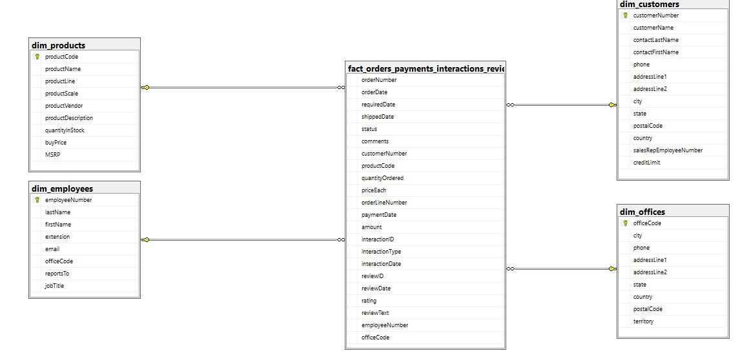
Data Warehouse Design for Customer Management Project:
Objective: To enhance the data structure for easier analysis, reporting, and decision-making.
We chose a Star Schema to simplify queries, improve performance, and make data easily accessible for business insights.
Overview of the tables:
Fact Table: fact_orders_payments_interactions_reviews
Dimension Tables: dim_customers, dim_products, dim_employees, dim_offices

Slide 11
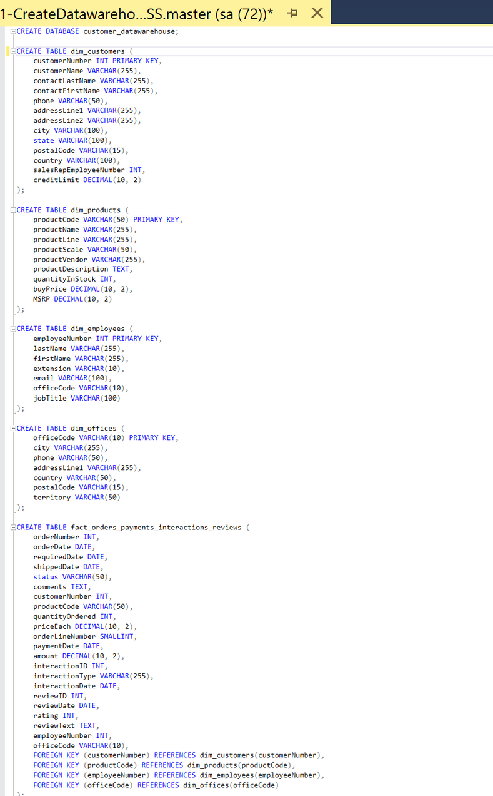
Table Details and Their Roles:
Fact Table (Transactional Data):
fact_orders_payments_interactions_reviews: Stores data related to orders, payments, customer interactions, and reviews.
Key columns: orderNumber, productCode, customerNumber, employeeNumber, interactionType, paymentDate
Dimension Tables:
Customers: Stores customer details like customerName, phone, address.
Products: Stores product information like productName, productScale, buyPrice.
Employees: Contains employee data like firstName, lastName, jobTitle.
Offices: Details about office locations and related info such as city, country, territory.

Slide 12
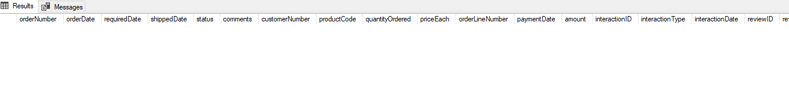

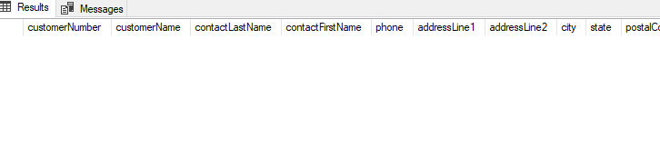
ETL PROCESS :
Home
Service
About Us
Contact
EXTRACT
WE PULL DATA FROM MULTIPLE TABLES,
SUCH AS CUSTOMERS, PRODUCTS, OFFICES
, AND EMPLOYEES, USING SQL QUERIES.
THIS IS ACHIEVED BY CONNECTING TO
THE OPERATIONAL DATABASE VIA
SQLALCHEMY.
FACT
1-
DIM_PRODUCT
DIM_CUSTOMER

Slide 13
ETL PROCESS :
Home
Service
About Us
Contact
TRANSFORM:
FROM [customer_management].[dbo].[orders] o
JOIN [customer_management].[dbo].[orderdetails] od ON o.[orderNumber] = od.[orderNumber]
JOIN [customer_management].[dbo].[customers] c ON o.[customerNumber] = c.[customerNumber]
JOIN [customer_management].[dbo].[products] p ON od.[productCode] = p.[productCode]
LEFT JOIN [customer_management].[dbo].[payments] pay ON c.[customerNumber] = pay.[customerNumber]
JOIN [customer_management].[dbo].[employees] e ON c.[salesRepEmployeeNumber] = e.[employeeNumber]
LEFT JOIN [customer_management].[dbo].[interactions] i ON c.[customerNumber] = i.[customerNumber]
LEFT JOIN [customer_management].[dbo].[productReviews] r ON p.[productCode] = r.[productCode]
""",
WHILE TRANSFERRING DATA,
WE ENSURE DATA INTEGRITY
AND STRUCTURE, SUCH AS JOINING RELATED TABLES LIKE ORDERS, ORDERDETAILS,
AND PAYMENTS TO FORM A FACT TABLE THAT CONSOLIDATES KEY BUSINESS TRANSACTIONS (ORDERS, PAYMENTS, INTERACTIONS,
AND REVIEWS).

Slide 14
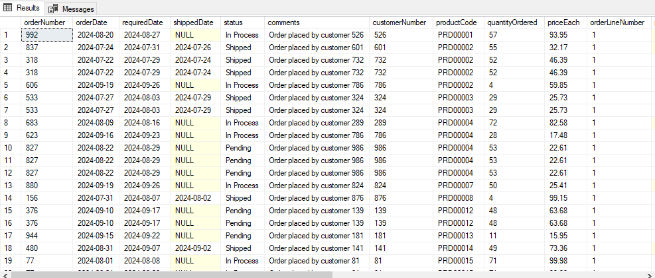
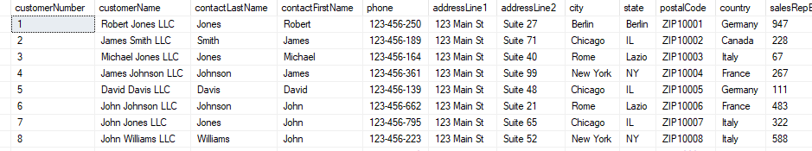
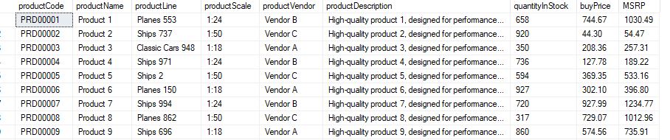
ETL PROCESS :
Home
Service
About Us
Contact
LOAD
THE PROCESSED DATA IS THEN LOADED INTO CORRESPONDING DIMENSIONAL TABLES (DIM_CUSTOMERS, DIM_PRODUCTS, ETC.) AND FACT TABLES IN THE DATA WAREHOUSE,USING TOOLS SQLALCHEMY , PANDAS.
NOW, READY FOR USE IN BUILDING
PREDICTIVE MODEL .

Slide 15
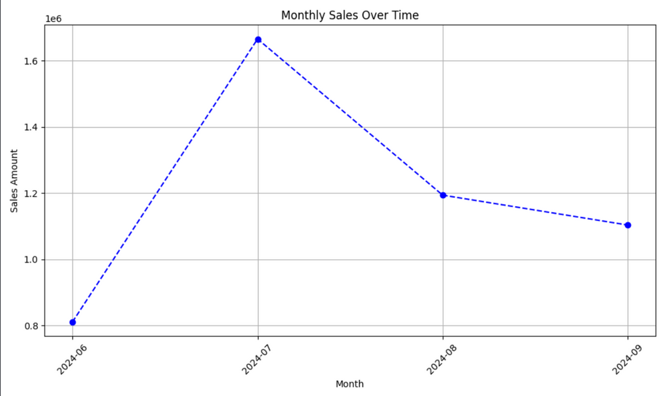
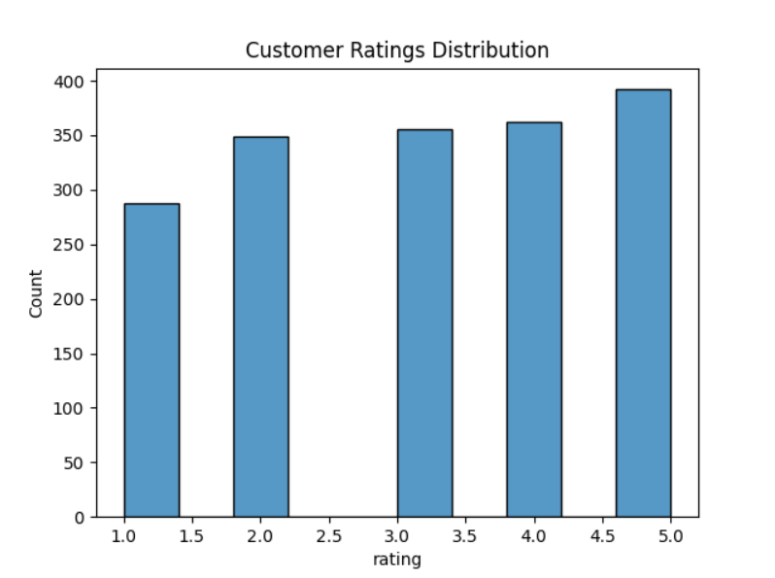
Analysis with matplotlib
This line graph depicts monthly sales from June to September 2024. Sales peaked in July and declined steadily thereafter. Further analysis is needed to understand the underlying factors influencing this trend.
This bar chart illustrates the distribution of customer ratings. The x-axis represents the rating scale (1-5), and the y-axis indicates the count of ratings. Most ratings fall between 3.5 and 5.0, indicating overall customer satisfaction.

Slide 16
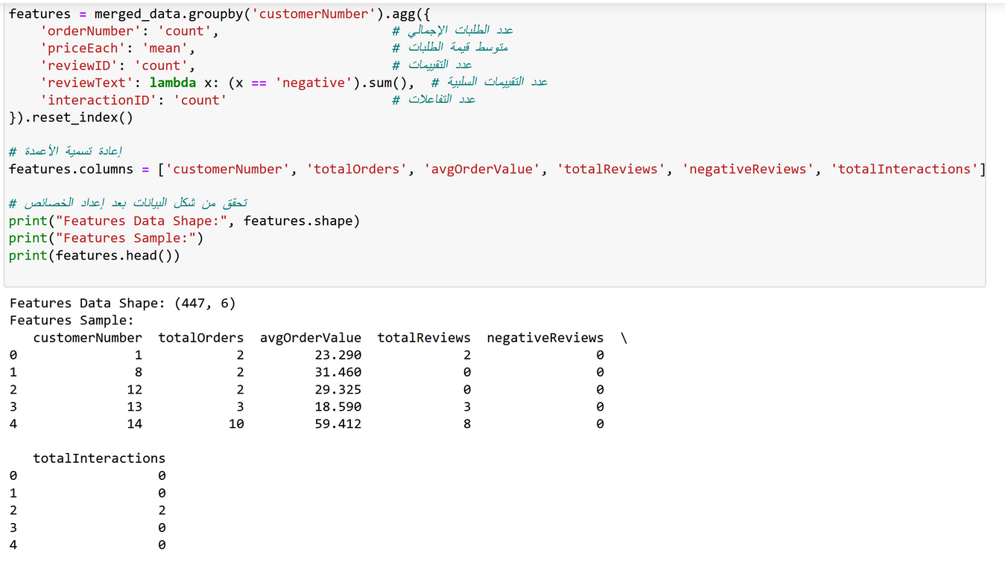
MODEL BUILDING PROCESS:
Data Reading: We started by reading the data from CSV files related to customers, offices, products, and employees, which provided the necessary information.
Data Merging: We merged the fact data with customer, office, product, and employee data to create a comprehensive dataset.
Feature Preparation: We calculated important features:
totalOrders: Total number of orders.
avgOrderValue: Average value of
orders.
totalReviews: Total number of
reviews.
negativeReviews: Number of
negative reviews.
totalInteractions: Total interactions.
Adding the New Column: We created
the "customerChurn" column to indicate
if a customer is likely to churn based on negative reviews.

Slide 17
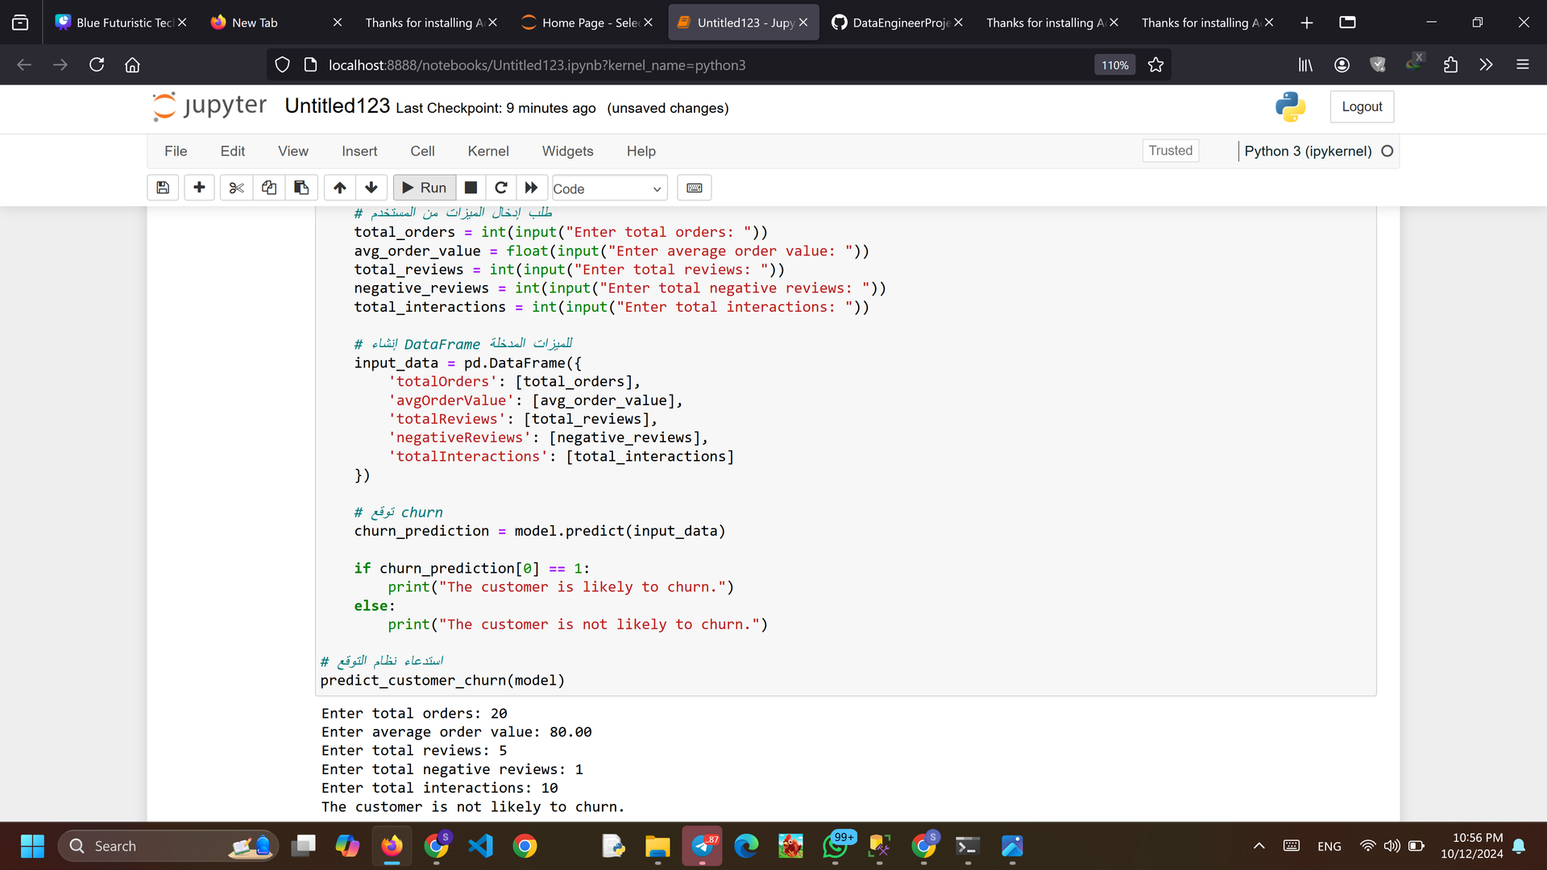
Model Results and Challenges :
Data Splitting: We divided the data into training and testing sets and used a Decision Tree Classifier for model building.
Model Evaluation: After training, we evaluated the model using the test set. The initial accuracy was 100%, but after adding noise, it dropped to 92%. We decided to continue with the first model.
Predictive System: The system allows users to input the following features to predict whether a customer will churn:
totalOrders
avgOrderValue
totalReviews
negativeReviews
totalInteractions

Slide 18

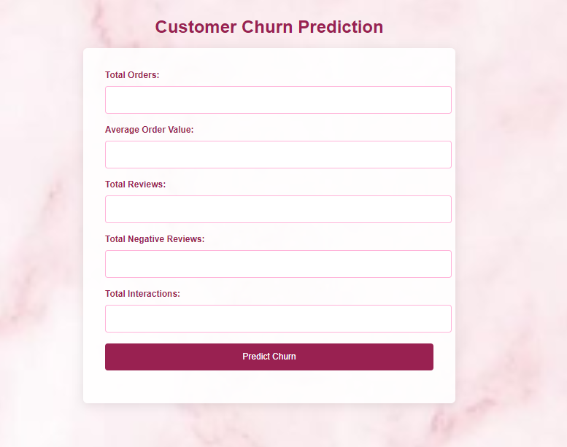
Studio Shodwe
Home
Service
About Us
Contact
FLASK WEB APPLICATION:
PURPOSE:
TURN THE CUSTOMER CHURN PREDICTION MODEL INTO AN INTERACTIVE WEB APPLICATION.
MAIN FEATURES:
USER-FRIENDLY INTERFACE FOR PREDICTIONS.
INTEGRATION WITH THE MACHIN LEARNING
MODEL.
CUSTOM FORMS FOR INPUT DATA.

Slide 19
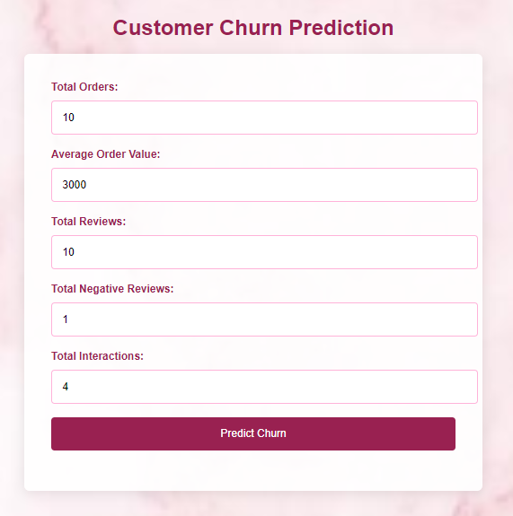
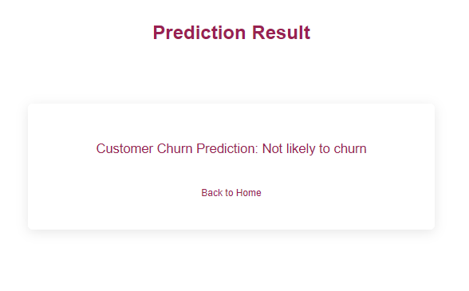

Studio Shodwe
Home
Service
About Us
Contact
FLASK WEB APPLICATION:
BASED ON THE CUSTOMER’S INTERACTIONS AND ORDER HISTORY, THE MODEL PREDICTS THAT THIS
CUSTOMER IS NOT LIKELY TO CHURN.

Slide 20
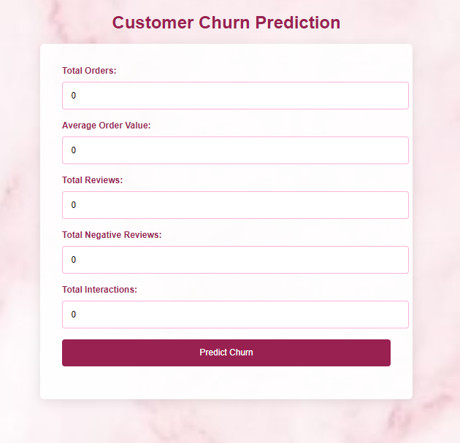
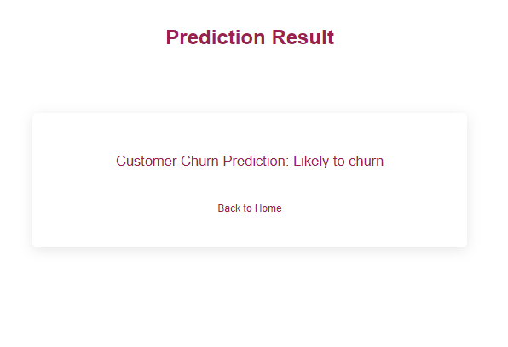
Studio Shodwe
Home
Service
About Us
Contact
FLASK WEB APPLICATION:
BASED ON THE CUSTOMER’S NEGATIVE REVIEWS AND REDUCED ACTIVITY, THE MODEL
PREDICTS THAT THIS CUSTOMER IS LIKELY TO CHURN

Slide 21

Studio Shodwe
Home
Service
About Us
Contact
CONCLUSION
"IN THIS PROJECT, WE STARTED WITH DATABASE DESIGN AND DATA WAREHOUSING, THEN MOVED ON TO BUILDING PREDICTIVE MODELS AND ANALYZING DATA.
USING POWERFUL TOOLS LIKE MICROSOFT SQL SERVER, PYTHON.
WE EFFECTIVELY MANAGED AND ANALYZED CUSTOMER DATA, TURNING IT INTO RELIABLE PREDICTIONS. THE DEPLOYMENT OF THE MODEL REFLECTS THE HARD WORK PUT INTO DATA PROCESSING, ANALYSIS, AND PREDICTION.

Slide 22
Studio Shodwe
Home
Service
About Us
Contact
CONCLUSION
THIS PROJECT CLEARLY SHOWS HOW DATA-DRIVEN SOLUTIONS CAN HELP UNDERSTAND CUSTOMER BEHAVIOR AND GIVE BUSINESSES THE TOOLS THEY NEED TO MAKE SMART DECISIONS.
AS WE LOOK TO THE FUTURE, DATA SCIENCE AND MACHINE LEARNING WILL CONTINUE TO REVOLUTIONIZE INDUSTRIES, AND THIS PROJECT STANDS AS A PROOF OF THE POWER OF INNOVATION AND TECHNOLOGY."

Slide 23
Studio Shodwe
Home
Service
About Us
Contact
THANK YOU

